Slide 1
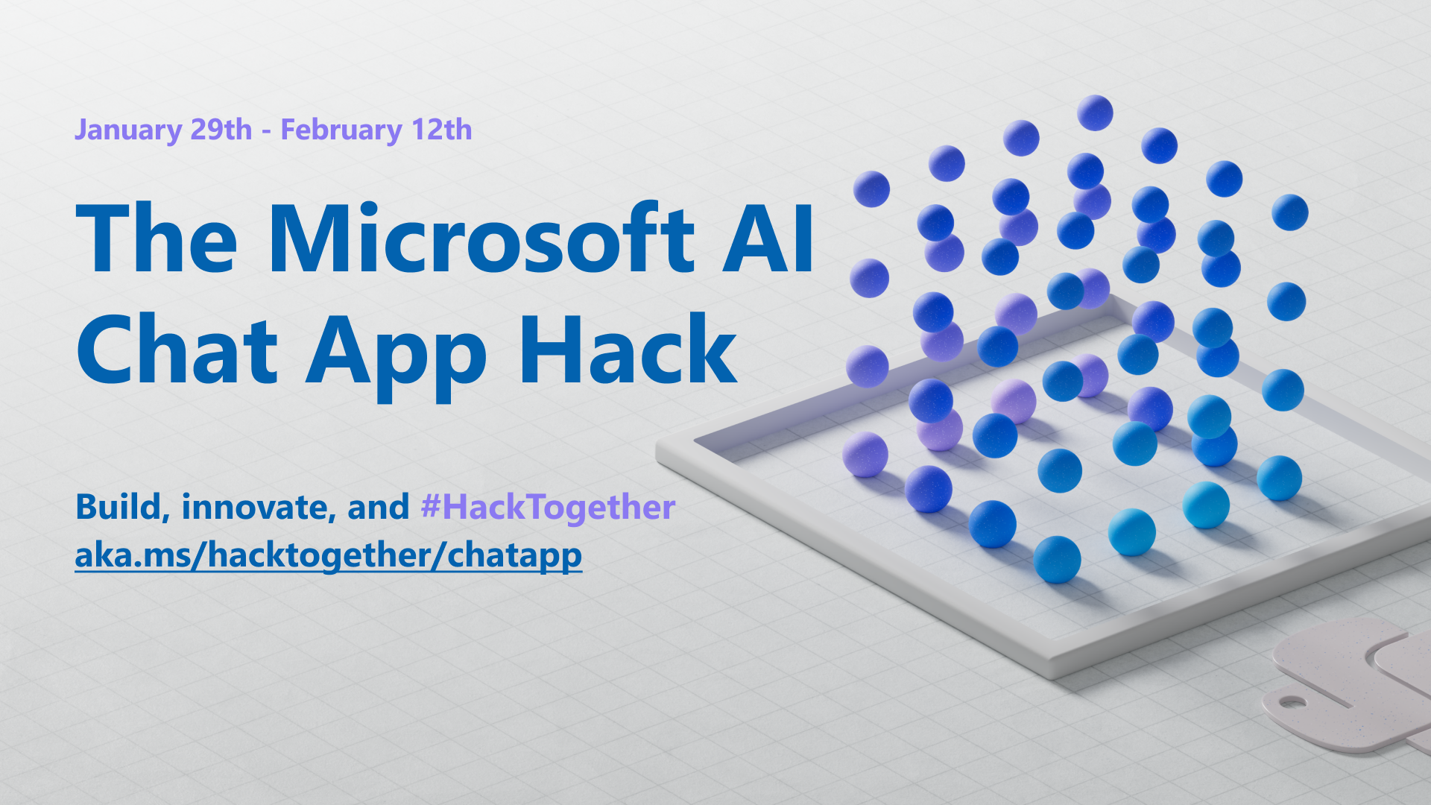

Slide 2
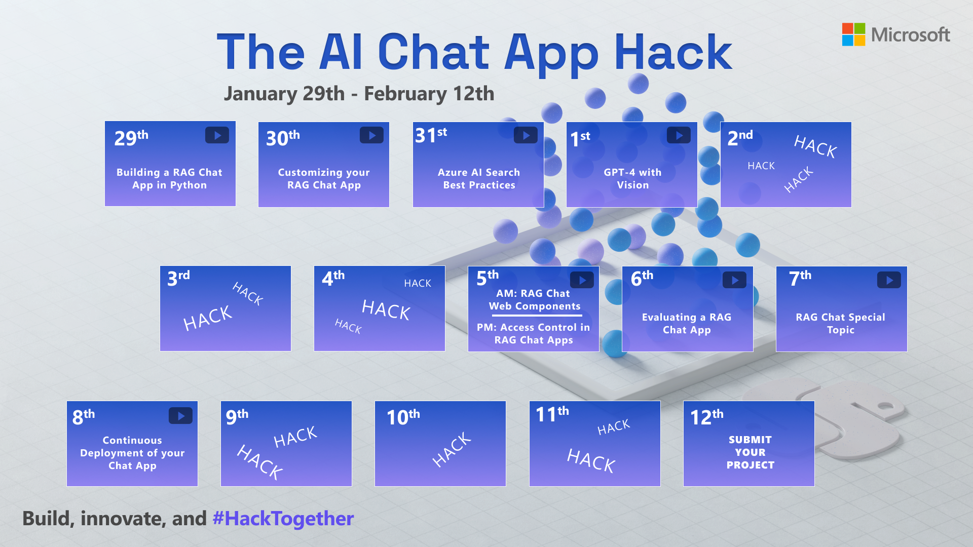
MVP sessions

Slide 3

Continuous Deployment of RAG Chat Apps

Slide 4
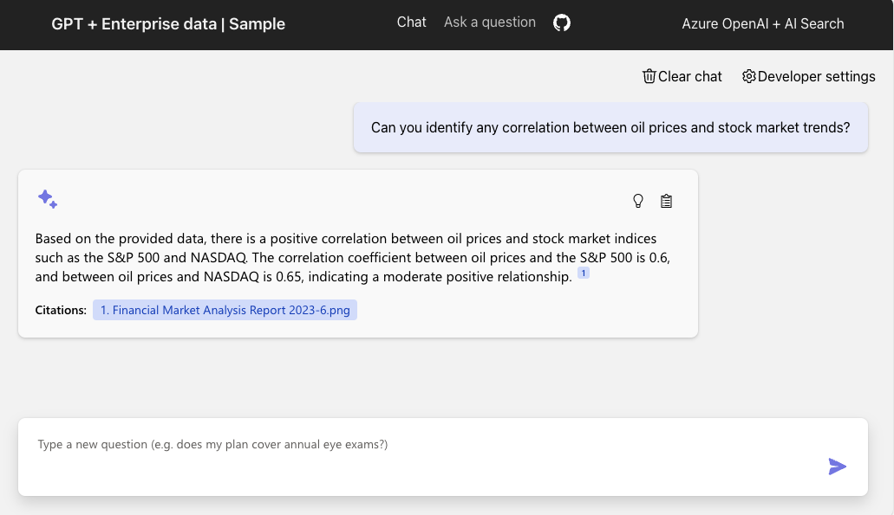
RAG chat app
Search results
+
Chat Completion
=
Answer with citations
https://github.com/Azure-Samples/azure-search-openai-demo/
aka.ms/ragchat

Slide 5

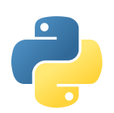




Azure architecture for RAG chat app
DATA INGESTION
Integrated vectorization
or
Local script
Azure Storage
Document
Intelligence
Python
Azure OpenAI
Azure
AI Search
Uploads PDF pages
Extracts data from PDFs
Splits data
into chunks
Computes embeddings
Stores in index
Azure
App Service
or
Local server
CHAT APP
Azure Storage
Azure OpenAI
Azure
AI Search

Slide 6
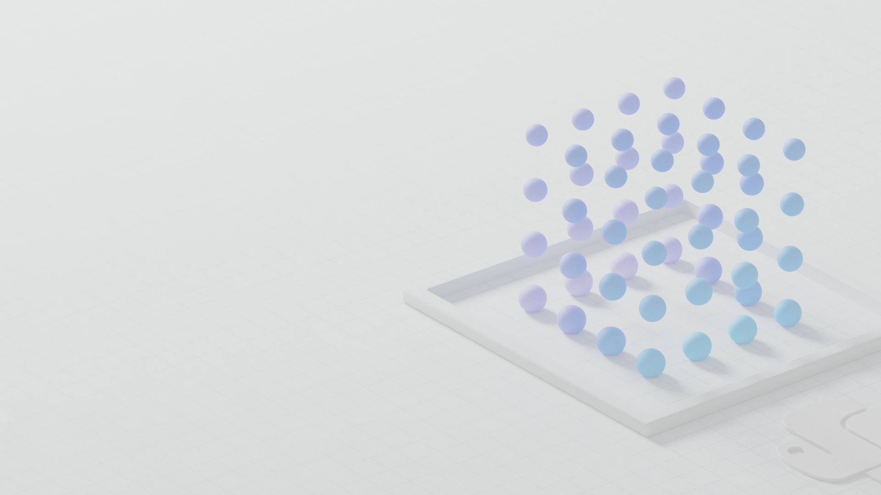
Manual
deployment
Notes:
And gaining intuition

Slide 7
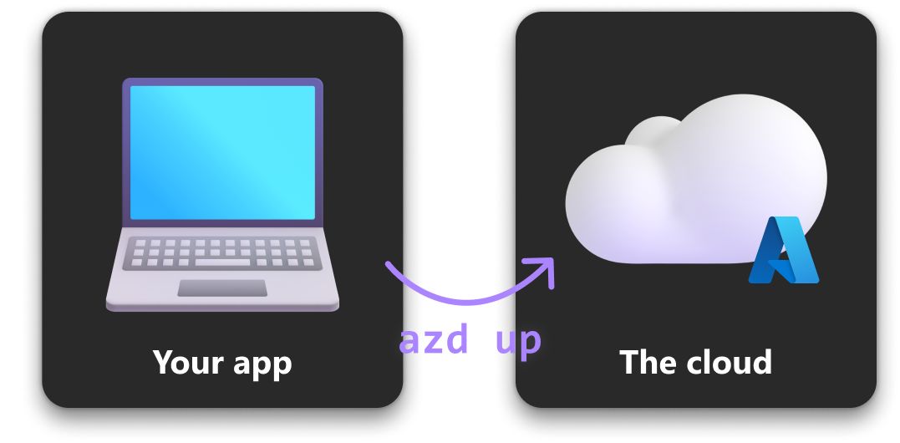
Deploying with azd
Use azd command (Azure Developer CLI) to easily get an app up on Azure.

Slide 8
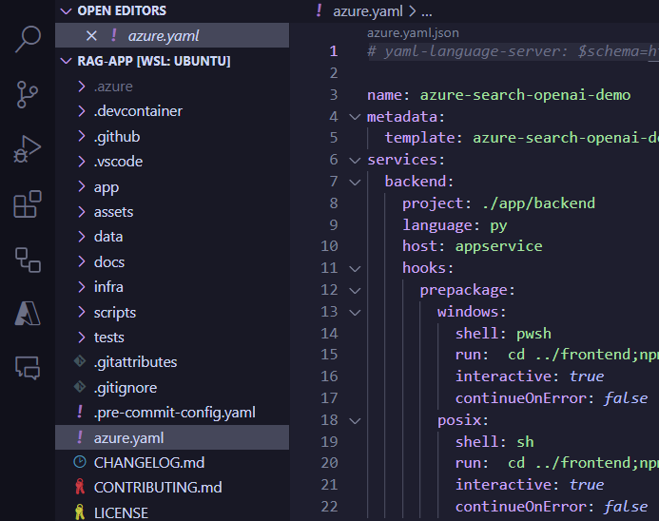
Project setup for azd
app/ with web application code
Bicep files to provision Azure resources
azure.yaml to specify the azd project and app metadata
Notes:
Explore them!

Slide 9
azd commands
Provision resources
azd provision
Deploy application code:
azd deploy
Do both!
azd up

Slide 10
Continuous
deployment
Notes:
And gaining intuition

Slide 11
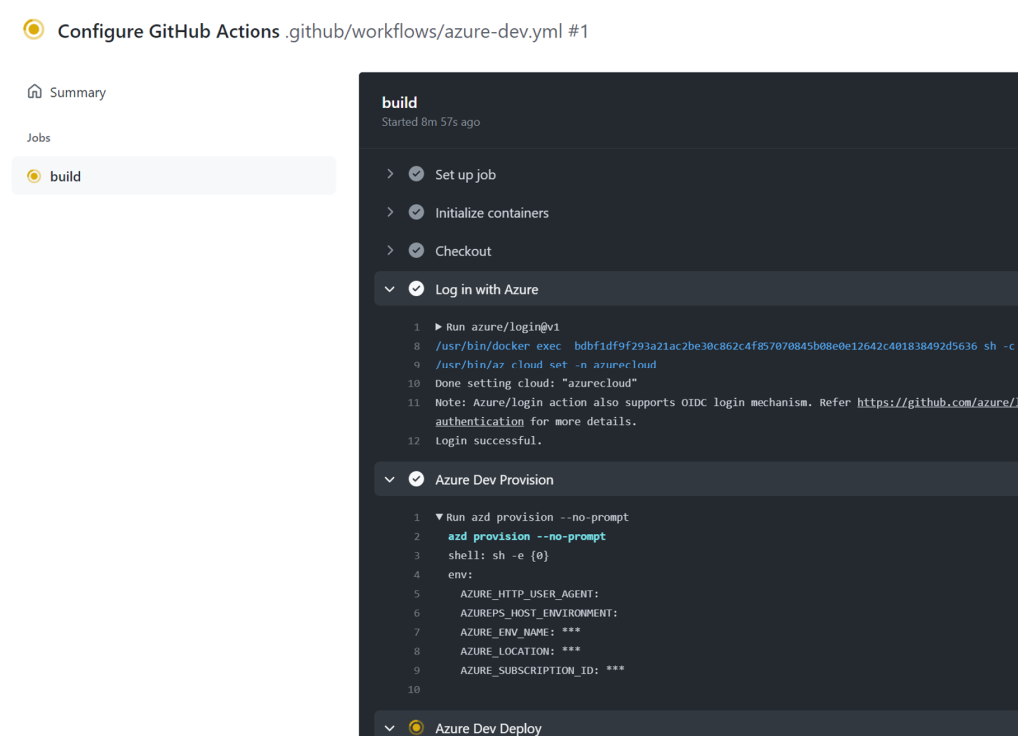
Goal
Deploy to Azure on push,
using a CI platform
like GitHub Actions
or Azure DevOps
https://github.com/Azure-Samples/azure-search-openai-demo/pull/1083
aka.ms/ragchat/workflow
Notes:
Demo: Show how to set up pipeline
Authentication: Who is doing the deployment?
Environment variables: How do we get them?
How to add azd env set…

Slide 12
Setting up a GitHub workflow
Add workflow file for GitHub actions:
.github/workflows/azure-dev.yaml
Make sure all necessary variables/secrets are declared in azure.yaml:
pipeline:
variables:
- AZURE_OPENAI_SERVICE …
Run command to configure all necessary Actions variables:
azd pipeline config
Notes:
Demo: Show how to set up pipeline
Authentication: Who is doing the deployment?
Environment variables: How do we get them?
How to add azd env set…

Slide 13
Customizing azd environment variables
If you previously did…
azd env set VAR_NAME value
azure.yaml knows which ones to sync and
azure-dev.yaml knows about existing environment variables.
When you set any azd env variables, re-run to sync new values:
azd pipeline config
Notes:
Demo: Show how to set up pipeline
Authentication: Who is doing the deployment?
Environment variables: How do we get them?
How to add azd env set…

Slide 14
Adding new azd environment variables
Add them to your workflow env:
env:
AZURE_SUBSCRIPTION_ID: $(AZURE_SUBSCRIPTION_ID)
NEW_VAR_NAME: $(NEW_VAR_NAME)
Add to azure.yaml:
pipeline:
variables:
- NEW_VAR_NAME …
When you change any azd env variables, re-run:
azd pipeline config
Notes:
Demo: Show how to set up pipeline
Authentication: Who is doing the deployment?
Environment variables: How do we get them?
How to add azd env set…

Slide 15
Using continuous deployment today
Either merge this PR or wait for it to get merged next week:
https://github.com/Azure-Samples/azure-search-openai-demo/pull/1083
aka.ms/ragchat/workflow
Then configure the workflow:
azd pipeline config
Notes:
Demo: Show how to set up pipeline
Authentication: Who is doing the deployment?
Environment variables: How do we get them?
How to add azd env set…

Slide 16
Next steps
Register for the hackathon →
Introduce yourself in our discussion forum
Deploy the repo with the sample data
See steps on low cost deployment →
Hack, hack, hack, hack! 🧑🏿‍💻 👩🏻‍💻 👩🏼‍💻
Post in forum if you have any questions. 🙋🏼 🙋🏾‍♀️ 🙋🏻
Submit your project before February 12th to win prizes! 💸💰💵
Join tomorrow’s sessions from MVPs!
aka.ms/hacktogether/chatapp
aka.ms/ragchat/free

